Slide 1


Project 3
Amazon Price Prediction by Godday and Ross

Slide 2

Project Goal
Using machine learning to predict the opening stock prices based off of previous opening prices.

Slide 3
Challenges
Communication – Staying in constant communication for our team was an issue due to outstanding personal life circumstances. Communication amongst teams can always be improved.
Simplicity – Our objective was to keep this application simple, but in its simplicity this limits the amount of data we can use for opening price prediction.
Time Assessment – The time we allotted ourselves to complete the project was inaccurate. We planned 6 days, actual was 9 days.
Graphing Data – We had trouble graphing our original input data and the model output side by side for comparison.

Slide 4
Project Timeline
4/2 – Project start, initial project discussion of technical approach
4/4 – Formal discussions in breakout rooms
4/6 – 2nd Project breakout room
4/8 – Projected finish date
4/11 – Power point started
4/12 – Power point tweaked for presentation
4/13 – Power point finished

Slide 5
Technical Approach
We utilized Yfinance to request the Amazon data, Pandas for data munging, and we used scikit-learn for 3 SVR models, and Matplotlib to create our scatter plots.
We used HTML and CSS for our deployment to github which we used for hosting purposes.

Slide 6
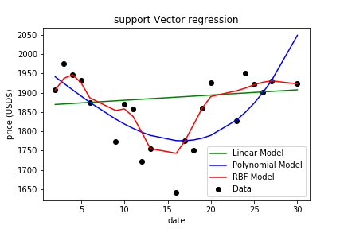
Results
1910.508164163097
It is clear that the RBF model has better predictive power based off the data points which were more clustered to the RBF line.
See our Jupyter notebook, the r squared on results advised that the RBF model has 76% test accuracy.

Slide 7
Project Takeaways
Given more time we would like to:
Create an application for investor use or widespread user use
Experimenting with outside variables to account for other influences on the opening price
Implementation of PlotLy or JS for user interface

Slide 8
Demonstration
https://godday-abuede.github.io/project3-challenge/

